Slide 1
Gartner HackElite Submission
Name: Aayush Mittal
Institute Name: IIT Kharagpur
Roll No.: 17MI10001
Notes:
UPDATED 24 April 2019
Presenter's Name
Presenter's Name

Slide 2
Recommendations
Activity 1 Time Period 0 has been the most important feature in the dataset, as per the TreeExplainer algorithm of SHAP (Shapley additive explanations). Hence, more effort must be put in to make the documentation user-friendly, precise and clear too get customer on board early on. Also number of documents usage especially on the starting month of contract is a key feature. Hence a proper supply of documents to clients must be ensured by the company.
Rate of retention is high for the clients whose contracts start in December; this is reflected by the high importance associated with the month_Dec feature. Hence, assigning more attention to capture new clients in December can turn out to be highly beneficial for Gartner.
Activity 4 Time Period 0 is another one important feature. Number of calls by Gartner service desk to help clients especially in the initial month of subscription must have a sufficient high value for client retention. This is a key feature which show the responsive and helping nature of the company to its clients
Flag 2 as interpreted by SHAP plot shows lower value have overall positive impact on client retention and higher have negative impact. So company should focus on why higher service category clients have a negative impact on retention and to improve the situation as flag two have a high SHAP value.

Slide 3
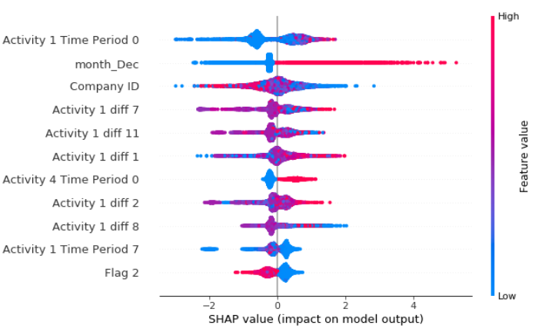
Recommendations
Figure 1 (SHAP Summary Plot)

Slide 4
Analysis and Feature Engineering
I assume that the companies that joined earlier have a smaller company ID. This interpretation reflects that older clients have higher chances of retention. This is observed by the decrease in the F1 score on dropping the company ID variable. Analysis plots for the same are provided (Figure 2). I also normalize the value of Company ID as it was a very high numerical value compared to other features.
I encoded Flag 4 into three different values. I encoded No:0, Unknown:0.998 and Yes : 1. The ratio of no/yes was around 1/500 on the overall training dataset, so I placed value of unknown as (1-1/500).
Cardinal features such as Flag 6 and Flag 1 have been one hot encoded.
Client Retention Flag, Flag 1 and Flag 3 were mapped to appropriate numerical values.
Apart from these existing features Activity 1 for all Time Period was having a major impact on Client retention, I added features as difference between each consecutive Time Period as new features. For e.g. Activity 1 diff 0 = Activity 1 Time period 1 – Activity 1 Time Period 0, etc. These features will capture the net decline and increase in Activity for all 12 months. Importance of these features were also very high as shown in figure 3. So, I decided to keep them in my model.
I also added mean of all 8 different Activities across 12 months as new features for eg. A1_mean, A2_mean, etc. These mean values represent the whole activity as a one feature instead of 12 different features across different months.

Slide 5
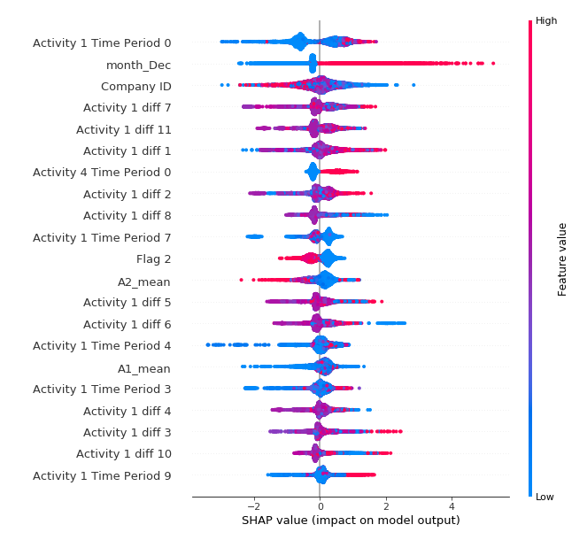
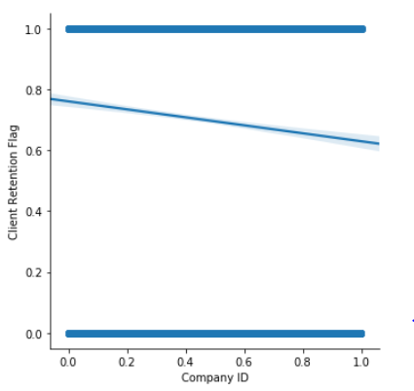
Analysis and Feature Engineering
Figure 2 (sns.lmplot)
Figure 3 (SHAP Summary Plot)

Slide 6
Approach for building model Structure
I have used LightGBM which a gradient boosting framework that uses tree based learning algorithms as my model.
I also applied ANN, SVM, Random Forest, Adaboost models but it was LightGBM that out performed all the models as it uses more regularized model to control overfitting, uses sparse matrices, and also uses improved data structures for better processor cache utilization which makes it and hence give better performance. I used did hyperparameter tuning in my LightGBM which further helped me increased the f1 score a bit more.
Accuracy – 0.995550
Sensitivity – 0.997082
Specificity – 0.991910

Slide 7
What are the most important activities that will impact client retention?
The most important activity is the document usage of client. Focusing in particular on document can be a key solution on client retention. We have seen that throughout 12 months Activity 1 has been a crucial feature in our model for the target variable and that is in a positive way. More the document usage more the chances of client retention.
After Activity 1, Activity 4 is the most important feature. Having frequent number of calls for service help can make sure the engagement as well as trust for Gartner. Activity 4 especially in initial months is a big factor of client retention.
Then comes Activity 3 and Activity 2. Gartner must maintain the usability of its social platform to engage the clients and also keep them updated with all the ongoing services. Also a proper enquiry generated in respective months is a key feature for client retention.

Slide 8
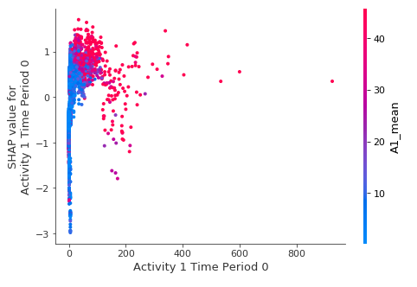
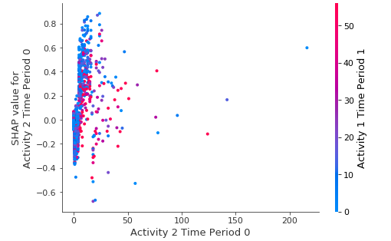
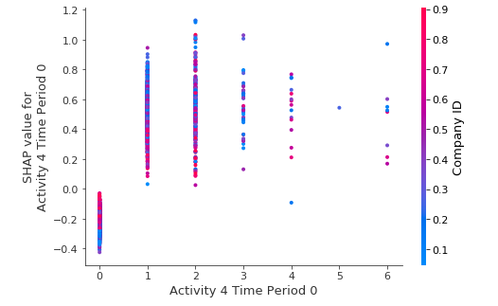
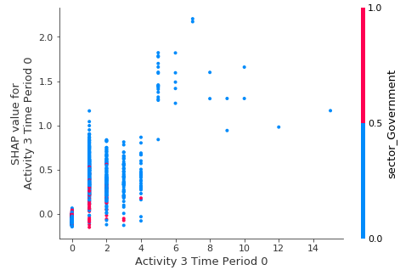
What are the most important activities that will impact client retention?
SHAP Dependence plot of top important Activities

Slide 9
What should be the order of these activities in client contract life cycle?
Activity one (No. of documents read by the client) , in the initial phase, is the most important activity in the activity cycle as this depicts the seriousness of the customer. Activity 4 (No. of call by Gartner) falls next in line as this helps Gartner keep the client in loop and harness maximum potential. The increasing involvement of the client results queries, this helps us understand the involvement of the customer in the consecutive time. As the queries are generated, clients tend to discuss the same on the social media platforms of Gartner. This is consequently followed by a series of conferences and symposiums which helps clients understand the issue on a broad perspective.
This is followed by a phase of detailed 1:1 meetings with the Gartner consultants, this increases specifically in the mid-year period. Finally the clients share their testimonials of their experience with Gartner, sowing the seeds for the next endeavor.

Slide 10
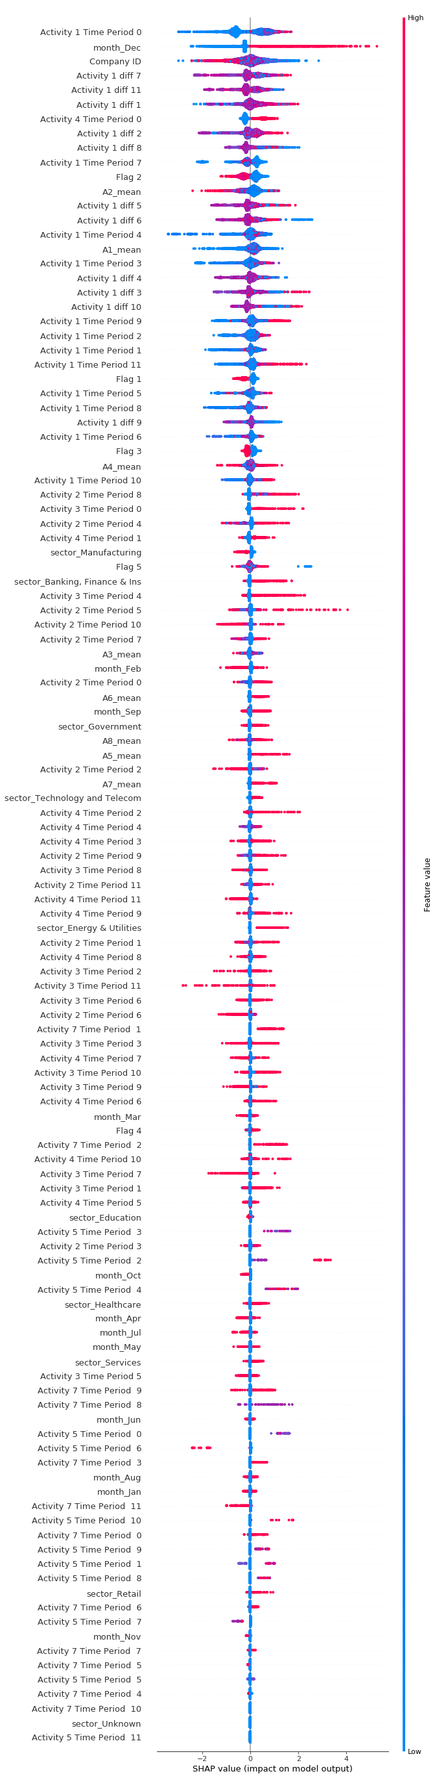
Which months are most important for client engagement for driving higher retention?
Month one has proven to be the most important to influence client retention. The variables of time period one have the maximum feature importance and hence have a direct impact on customer retention. Specific attention must be paid towards circulating concise documents amongst the clients and regular updates must be maintained through phone calls to increase retentions. Therefore at Gartner, we must invest more resources and time to capture clients early on.
Following this, the next months of importance are the fourth and eight month as the Activities 5 and 7 turn out to be of importance in these months and hence must be taken care of. The conferences conducted later down the line play an essential role in influencing the behavior of the customers. One on one conversations are necessary to build strong long term relations.

Slide 11
What activities should service associate recommend in first month to drive higher engagement in subsequent months?
We have observed that the No. of documents read by the client (Activity 1) in the period zero is the most important and information rich predictor. From the observed trend we conclude that higher number of documents read initially contributes positively towards customer retention.
Hence, the Gartner team must focus on primarily ensuring that documents are prepared in a concise and client-friendly manner and circulated well.
Secondly, we have observed that the extent of Activity 4 (Calls by Gartner) plays an essential role in the first month. Hence proper follow up and support through calls must be ensured to establish a firm channel of communication. This builds trust and also develops a sense of confidence for the client.
Lastly, the number of queries generated affects the client retention rate. Hence, Gartner must take marketing moves to increase queries and try and convert as many queries as possible.

